Slide 1
UML Modeling
Instructor: Mehroze Khan

Slide 2
How are design ideas communicated in a team environment?
If the software is large scale, employing perhaps dozens of developers over several years, it is important that all members of the development team communicate using a common language.
This isn’t meant to imply that they all need to be fluent in English or C++, but it does mean that they need to be able to describe their software’s operation and design to another person.
That is, the ideas in the head of say the analyst have to be conveyed to the designer in some way so that he/she can implement that idea in code.
Just as mathematicians use algebra and electronics engineers have evolved circuit notation and theory to describe their ideas, software engineers have evolved their own notation for describing the architecture and behaviour of software system.
That notation is called UML. The Unified Modelling Language. Some might prefer the title Universal Modelling language since it can be used to model many things besides software.

Slide 3
What is UML ?
UML is not a language in the same way that we view programming languages such as C++, Java or Python.
UML is however a language in the sense that it has syntax and semantics which convey meaning, understanding and constraints to the reader and thereby allows two people fluent in that language to communicate and understand the intention of the other.
UML represents a collection of graphical notations to capture requirements and design alternatives.
UML is to software engineers what building plans are to an architect and an electrical circuit diagrams is to an electrician.
UML is suitable for large scale projects
Notes:
Note: UML does not work well for small projects or projects where just a few developers are involved. If you attempt to use it in this environment it will seem more of a burden than an aid, but then it was never intended for that. It works best for very complex systems involving dozens of developers over a long period of time where it is impossible for one or two people to maintain the structure of the software in their head as they develop it.

Slide 4
Models and Multiple Views
UML is used to model (i.e., represent) the system being built.
It is impossible to capture all the subtle details of a complex software system in just one large diagram.
The UML has numerous types of diagrams, each providing a certain view of your system

Slide 5
Diagram Taxonomy
UML diagrams can be classified into two groups: structure diagrams and behavior diagrams.
System complexity is driven both by the number and organization of elements in the system (i.e., structure) and the way all these elements collaborate to perform their function (i.e., behavior).

Slide 6
Structure Diagrams
These diagrams are used to show the static structure of elements in the system, architectural organization of the system, the physical elements of the system, its runtime configuration.
Structure diagrams are often used in conjunction with behavior diagrams to depict a particular aspect of your system. Each class may have an associated state machine diagram that indicates the event-driven behavior of the class’s instances.
Following are the Structure Diagrams in UML:
■ Package diagram
■ Class diagram
■ Component diagram
■ Deployment diagram
■ Object diagram
■ Composite structure diagram

Slide 7
Behavior Diagrams
Events happen dynamically in all software-intensive systems: Objects are created and destroyed, objects send messages to one another in an orderly fashion, external events trigger operations on certain objects.
Following are the Behavior Diagrams in UML:
■ Use case diagram
■ Activity diagram
■ State machine diagram
■ Interaction diagrams
■ Sequence diagram
■ Communication diagram
■ Interaction overview diagram
■ Timing diagram

Slide 8
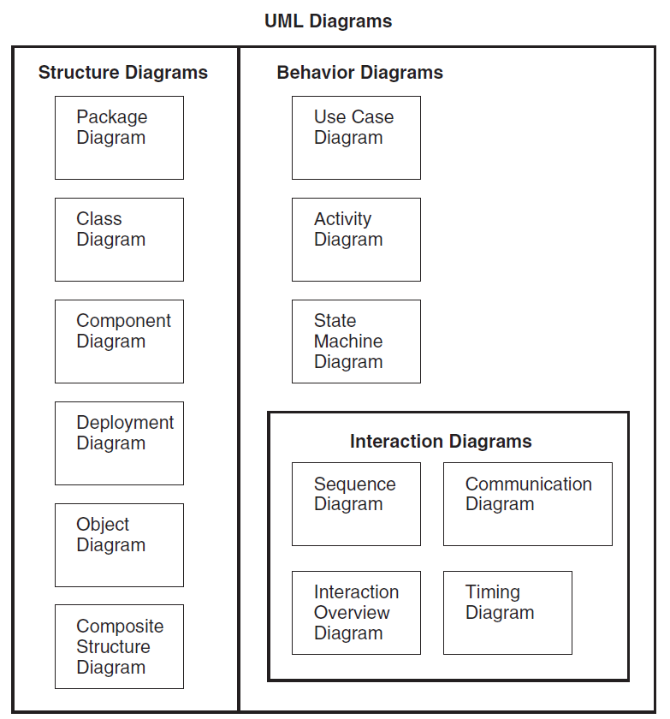
UML Diagrams

Slide 9
Definition of a Use-Case
A process or procedure, describing a user’s interaction with the system (e.g. library) for a specified, identifiable purpose. (e.g. borrowing a book).
As such, each Use-Case describes a step-by-step sequence of operations, iterations and events that document
The Interaction taking place.
The Measurable Benefits to the user interacting with the system
The Effect of that Interaction on the system.
It is important to document these use-cases as fully as possible as each use-case captures some important functionality that our system will have to provide.
Notes:
Each use case represents a discrete goal for the user

Slide 10
Use Cases in Iterative Development
Functional requirements are primarily captured in use cases
Use cases drive the iteration planning and work
Easy for users to understand

Slide 11
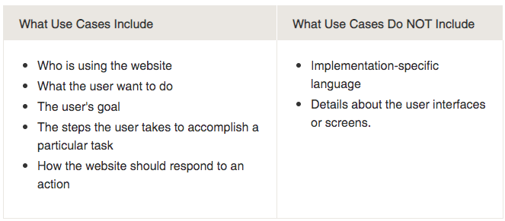
What ‘should’ and what ‘shouldn’t ‘ be included in use cases?

Slide 12
How to Find Use Cases?
Choose the system boundary
what are you building?
who will be using the system?
what else will be used that you are not building?
Find primary actors and their goals
brainstorm the primary actors first who starts and stops the system?
who gets notified when there are errors or failures?
Define use cases that satisfy user goals
prepare an actor-goal list in general, one use case for each user goal
name the use case similar to the user goal

Slide 13
What Tests Can Help Find Useful Use Cases?
Which of these are valid use cases?
Negotiate a Supplier Contract
Handle Returns
Log in
Move Piece on the Game Board
All of these can be use cases at different levels,
depending on the system, boundary, actors, and goals

Slide 14
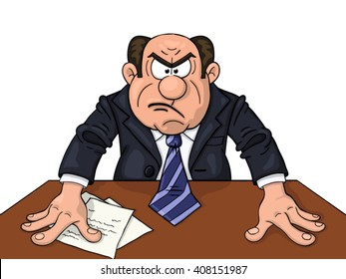
What Tests Can Help Find Useful Use Cases?
Rather than asking ”What is a valid use case?”
More practical question:
“What is a useful use case?”
Rules of thumb
The Boss Test
The EBP Test
The Size test

Slide 15
What Tests Can Help Find Useful Use Cases?
Boss test
“What have you been doing all day?”
Your reply “logging in!”
Is your boss happy? No value? No good use case!
Elementary Business Process (EBP) test
A task performed by one person in one place at one time, in response to a business event, which adds measurable business value and leaves data in a consistent state
Good Examples: Approve Credit or Price Order
Bad Examples: Delete a line item or print the document
Size test
Just a single step in a sequence of others -> not good!
Example: Enter an Item Id
Notes:
Doesn’t mean to always ignore boss-test-failing use cases. User authentication may fail the boss test but may be important and difficult.
EBP Test: It’s not a single small step like “delete a line item” or “print the document.” Rather, the main success scenario is probably five or ten steps. It doesn’t take days and multiple sessions, like “negotiate a supplier contract”; it is a task done during a single session. It is probably between a few minutes and an hour in length.
Size Test: A common mistake in use case modeling is to define just a single step within a series of related steps as a use case by itself, such as defining a use case called Enter an Item ID. You can see a hint of the error by its small size—the use case name will wrongly suggest just one step within a larger series of steps

Slide 16
Applying Tests
Handle returns
OK with the Boss. EBP. Size is good.
Log in
Boss is not happy is this is all you do all day!
Move piece on game board
Single step – fails the size test.

Slide 17
Use Case Diagram Concepts
Summarizes all use cases (for the part of the system being modeled) together in one picture
Typically drawn early in the SDLC
Shows the associations between actors and use cases

Slide 18

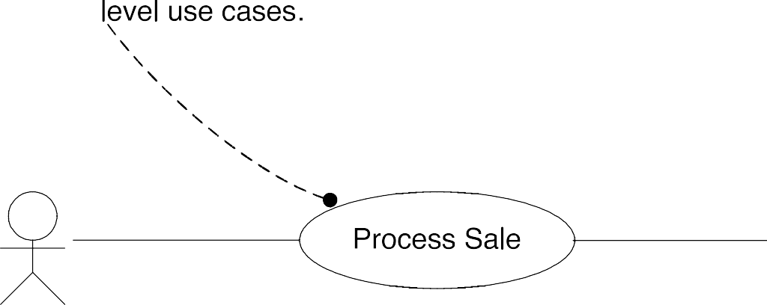

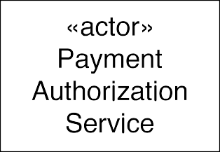

Use Case (Context) Diagrams: Suggested Notation
secondary/supporting actors on the right
Notes:
The users or systems that interact with the main system are called actors. An actor can be primary or secondary.
Primary actors are those that initiate use cases and interact with the system. They are usually placed on the left side of the system. On the other hand, secondary actor supports the system in completing a use case but does not initiate the use case. They provide services or information to the system as part of the primary actor's request.

Slide 19
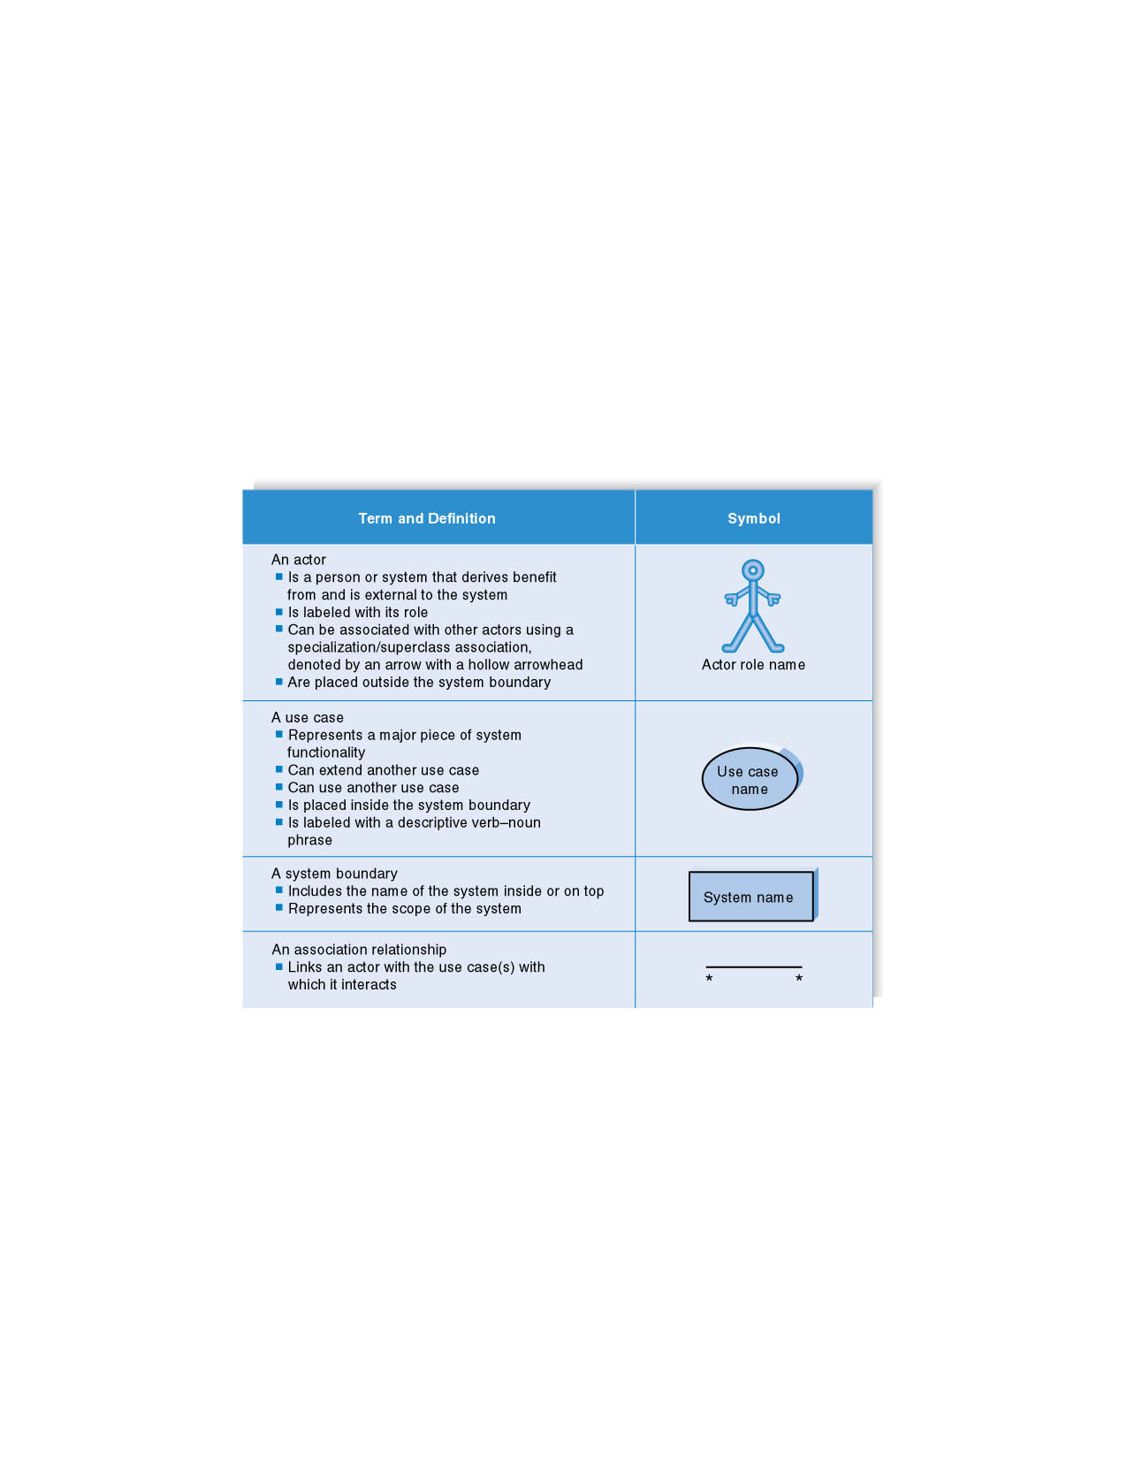

Syntax for Use Case Diagram
Notations
Name of the system

Slide 20
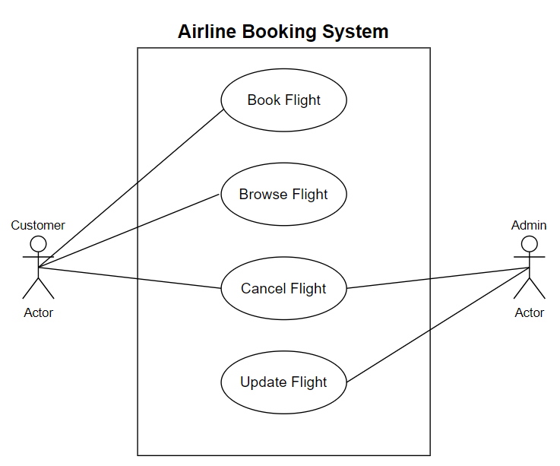
Use Case Diagram for Airline Booking System
Secondary Actor
Primary Actor

Slide 21
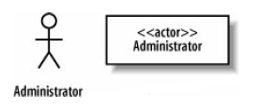
Example
The requirement indicates that the Administrator interacts with the system to create a new blogger's account
Requirement 1
The content management system shall allow an administrator to create a new blog account, provided the personal details of the new blogger are verified using the author credentials service.
The
Administrator interacts with the system and is not part of the system; thus, the Administrator
Is an Actor.
It's actually worth being very careful when naming your actors. The best approach is to use a name that can be understood by both your customer and your system designers.

Slide 22

Example
What can be the use case in our Requirement 1?
to create a new blog account
Requirement 1
The content management system shall allow an administrator to create a new blog account, provided the personal details of the new blogger are verified using the author credentials service.
UML Representation

Slide 23
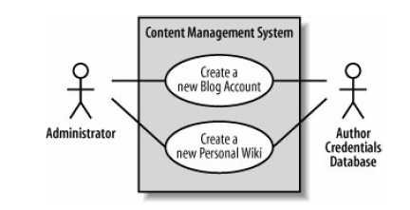
Example (Cont)
Requirement 2
The content management system shall allow an administrator to create a new personal Wiki, provided the personal details of the applying author are verified using the Author Credentials Service.
Author Credentials Service

Slide 24
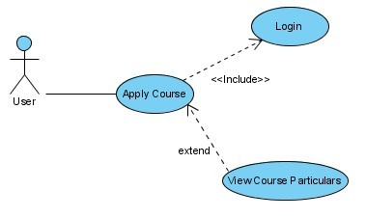
Example of Stereotypes – Include and Extend
Slide 2 (of 48)
Notes:
When a use case is depicted as using the functionality of another use case, the relationship between the use cases is named as include or uses relationship.
In UML modeling, you can use an extend relationship to specify that one use case (extension) extends the behavior of another use case (base).

Slide 25
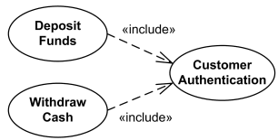
Example – Include and Extend
User
Slide 2 (of 48)

Slide 26
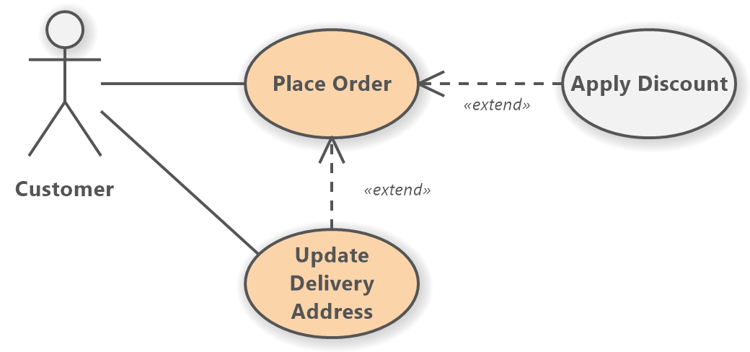
Example – Include and Extend
Slide 2 (of 48)

Slide 27
Include and Extend Relationships
The use of include and extend is discouraged simply because they add unnecessary complexity to a Use Case diagram.
Only use them if they are necessary.
Slide 2 (of 48)

Slide 28
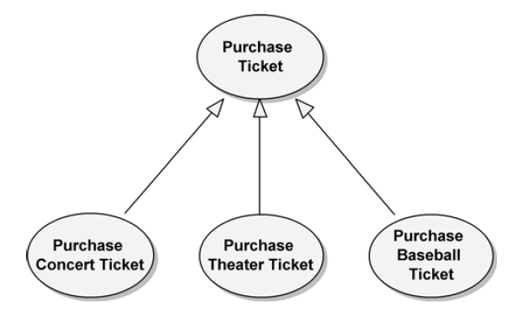
Generalization
Generalization relationships can also be used to relate use cases. As with classes, use cases can have common behaviors that other use cases (i.e., child use cases) can modify by adding steps or refining others.
Purchase Ticket contains the basic steps necessary for purchasing any tickets, while the child use cases specialize Purchase Ticket for the specific kinds of tickets being purchased.

Slide 29
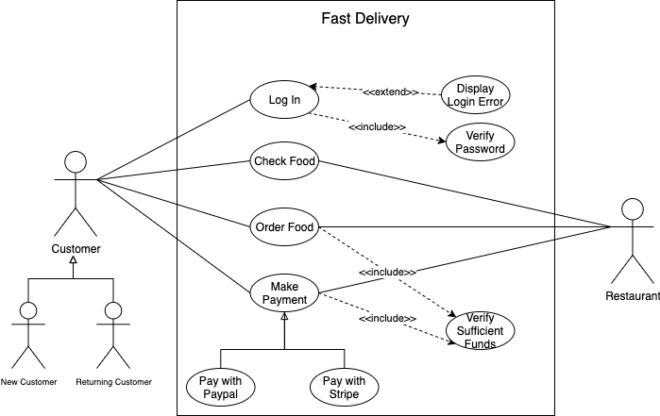
Example

Slide 30
References
Object-Oriented Analysis and Design with Applications, Grady Booch et al., 3rd Edition, Pearson, 2007.
Timothy C. Lethbridge, Robert Laganaiere, Object-Oriented Software Engineering (2nd Edition), McGraw Hill, 2005
Object-Oriented Modeling and Design with UML, Michael R. Blaha and James R. Rumbaugh, 2nd Edition, Pearson, 2005.
Larman, Craig. Applying UML and patterns: an introduction to object oriented analysis and design and interative development. Pearson Education India, 2012.

